Slide 1
RUNGTA COLLEGE OF DENTAL SCIENCES AND RESEARCH
REGENERATIVE ENDODONTICS
DEPARTMENT OF CONSERVATIVE DENTISTRY AND ENDODONTICS

Slide 2
Specific learning Objectives
At the end of this presentation the learner is expected to know ;
Core areas* | Domain ** | Category #
Introduction | Cognitive | Nice to know
Definitions | Cognitive | Must know
Indications | Cognitive | Must know
Single vs Multiple visit endodontics | Cognitive | Must know

Slide 3
CONTENT
INTRODUCTION
HISTORY
DEFINITIONS
PRESENT SCENARIO OF REGENERATIVE ENDODONTICS
GOALS & OBJECTIVES
TRILOGY OF REGENERATION
Stem Cells
Growth Factors/Morphogens
Scaffolds
Delivery System
CLINICAL STUDIES ON REGENERATIVE ENDODONTICS
Clinical Procedures Related to Regenerative Endodontics
Overview of Clinical Revascularization Cases
AAE Revascularization Protocol
Newer Approaches for regenerative endodontics
Clinical Measures of Treatment Outcome
CONCLUSION
REFERENCES

Slide 4
INTRODUCTION
Millions of teeth are saved each year by root canal therapy. Although current treatment modalities offer high levels of success for many conditions, an ideal form of therapy might consist of regenerative approaches in which diseased or necrotic pulp tissues are removed and replaced with healthy pulp tissue to revitalize teeth.
Regenerative endodontics is the creation and delivery of tissues to replace diseased, missing, and traumatized pulp.
Combination of disinfection or debridement of infected root canal systems
Apical enlargement to permit revascularization and use of adult stem cells, scaffolds, and growth factors
Peter Murray et al JOE 2007

Slide 5
Challenges - potential benefits to patients and the profession are equally ground breaking
Restore natural function instead of surgical placement of an artificial prosthesis.

Slide 6
HISTORY
Foundation of tooth regeneration - stomatologist G. L. Feldman (1932) proposed
Biological-aseptic principle of tooth therapy→ regeneration of pulp
Used dentine fillings for stimulating pulp regeneration
In 1957, Gavrilov demonstrated regeneration of dentin and cementum of tooth root in dogs

Slide 7
Regeneration of pulp → key to regenerative endodontic procedures → Ostby in 1961
In 2001, Iwaya et al. described a procedure termed revascularization that resulted in thickening of the root canal walls and continued root development
In 2004, Banchs and Trope proposed a clinical protocol for revascularization of infected immature teeth
Ramta Bansal, Current overview on challenges in Regenerative Endodontics, JCD 2015
Notes:
These two can be credited for sparking interest in regenerative endodontics

Slide 8
DEFINITIONS
Tissue Engineering
An interdisciplinary field that applies the principles of engineering and the life science towards the development of biological substitutes that restore, maintain or improve tissue function. (Langer & Vacanti, 1993)
Tissue engineering is the employment of biologic therapeutic strategies aimed at the replacement, repair, maintenance, and/or enhancement of tissue function.
(Franklin, Murray, Hargreaves JOE, 2008).

Slide 9
Tissue Regeneration:
Replacement of injured tissue by the same resident cells, or by differentiation of progenitor/stem cells into tissue committed cells.
(Kumar et al. 2009, Majno & Joris 2004)
Stem cells:
Stem cells are defined as clonogenic cells capable of both self renewal and multi-lineage differentiation.
Notes:
.[10]

Slide 10
Morphogens / Signaling molecules
Morphogens or signaling molecules are proteins that bind to receptors on the cell and induce cellular proliferation and/or differentiation.
Scaffold
Provides a physicochemical and biological three-dimensional micro environment for cell growth and differentiation, promoting cell adhesion and migration.

Slide 11
Regenerative endodontics
Defined as biologically based procedures designed to replace damaged structures such as dentin, root structures, and cells of the pulp-dentin complex.
AAE Glossary of Endodontic Terms, 2012

Slide 12
Repair Vs Regeneration
Repair | Regeneration
Healing occurs because remaining damaged tissue is vital | The damaged tissue is completely necrotic
Repair is defined as the process when healing takes place by proliferation of connective tissue elements resulting in fibrosis and scarring | Regeneration is defined as the process when healing takes place by proliferation of parenchymal cells and usually results in complete restoration of the original tissues.

Slide 13
Is RET a regenerative or reparative process?
In animal and human studies, the damaged pulp tissue in the canal space of immature teeth after RET is replaced by bone-, cementum-, and periodontal ligament-like tissue.
Therefore, RET is considered a reparative and not a regenerative process histologically
Lin & Rosenberg 2011, Simon et al. 2014.

Slide 14
OBJECTIVE
The objectives of regenerative endodontic procedure, are to:
Regenerate pulp like tissue, ideally pulp - dentin complex
Regenerate damaged coronal dentin, following a caries exposure
Regenerate resorbed root, cervical or apical dentin

Slide 15
GOALS OF REGENERATIVE PROCEDURES
Primary goal
Secondary goal
Tertiary goal
Pinnacle of regenerative goals
Elimination of symptoms & evidence of bone healing
Increase root wall thickness & increase root length
Positive response to vitality testing
Histologic confirmation for structural & functional restoration

Slide 16
BIOLOGICAL BASIS FOR REGENERATIVE ENDODONTIC THERAPY
Long-term calcium hydroxide → induce apexification of the immature tooth with pulpal necrosis → before obturation
Success rate of calcium hydroxide apexification is reported to be as high as 95%

Slide 17
LIMITATION
Barrier formed porous
Makes tooth brittle due to hygroscopic & proteolytic properties
Long term therapy & multiple visits
Strengthening of blunder buss canal not achieved

Slide 18
MTA
More reliable barrier formation
Lesser appointments
success rate of the treatment is as high as 94%.
Prospective clinical trials - success rate of the former is comparable to or higher than that of the latter

Slide 19
Apexification treatments no further root development
Immature teeth → vulnerable to cervical root fractures.
Regenerative endodontics → increased root development → a better long-term prognosis
Successful regeneration of the pulp-dentin complex → vital tissue capable of mounting an immune response and signaling tissue damage by sensory neurons

Slide 20
ARGUMENTS SUPPORTING REGENERATIVE ENDODONTICS
In terms of esthetics. there is a potential risk that endodontic filling materials and sealers may discolor the tooth crown.
A retrospective study of tooth survival times → root canal filling Vs tooth restoration → root canal therapy prolonged tooth survival
But the removal of pulp in a compromised tooth may still lead to tooth loss in comparison with teeth with normal tissues
van der Burgt TP. Plasschaert AJ .Tooth discoloration induced be dental
materials. Oral Surg Oral Med Oral Pathol 1995
Caplan DJ, cai J, yin G, While BA Root canal filled versus non-root canal filled
teeth, a retrospective comparison of survival times
J Public Health Dent 2005

Slide 21
NECROSED TEETH
TRADITIONAL ENDODONTICS
IMMATURE APEX
Apexification
MATURE APEX
RCT
REGENERATIVE ENDODONTICS
IMMATURE APEX
Revascularisation
MATURE APEX
Stem cell therapy
Pulp implantation
Scaffold implant
Gene therapy
No dentine wall thickening
Tooth structure loss
Revitalisation of pulp
space with functional
tissue capable of dentine deposition

Slide 22
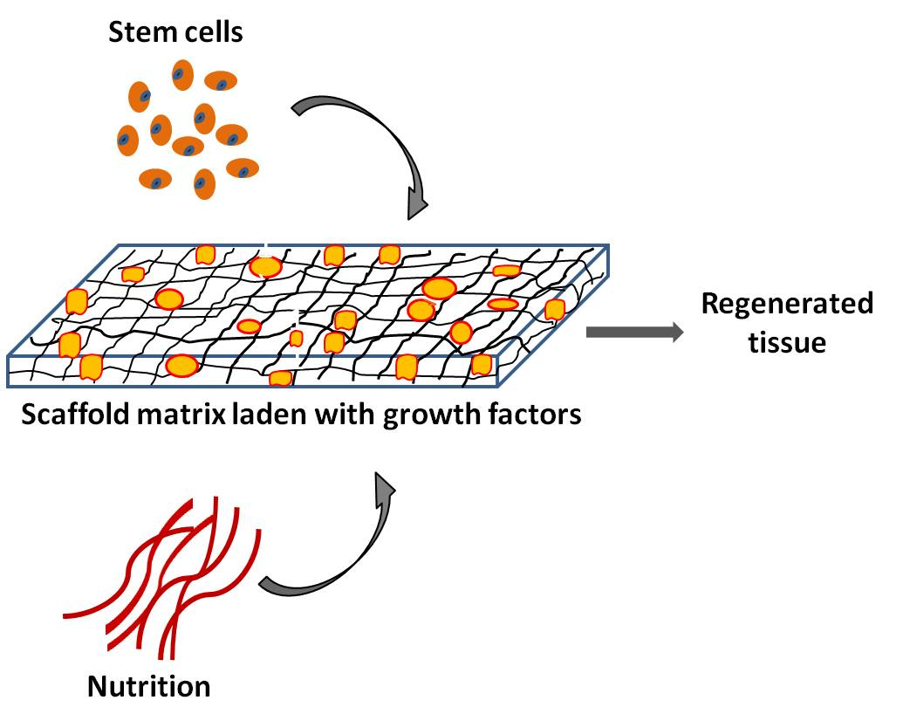
TRILOGY OF REGENERATION
Three major components of pulp regeneration
A reliable cell source capable of differentiating into odontoblasts
An appropriate scaffold to promote cell growth and differentiation
Growth factors that are capable of stimulating cellular proliferation and
directing cellular differentiation

Slide 23
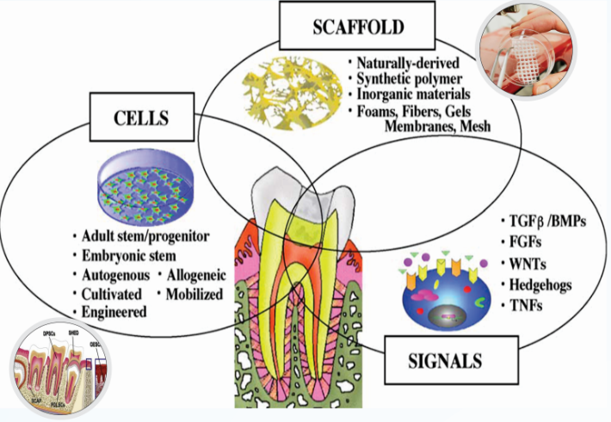

Slide 24
STEM CELLS
A stem cell is defined as a cell that can continuously produce unaltered daughters and furthermore, has the ability to generate cells with different and more restricted properties

Slide 25
A stem cell is commonly defined as a cell that has the ability to continuously divide and produce progeny cells that differentiate (develop) into various other types of cells or tissues
Rao MS. Stem sense: a proposal for the classification of stem cells. Stem Cells Dev 2004

Slide 26
The plasticity of the stem cell defines its ability to produce cells of different tissues

Slide 27
TAKE HOME MESSAGE
The clinical success rates of endodontic treatment can exceed 90%, regenerative endodontic methods have the potential for regenerating pulp and dentin tissues and therefore may offer an alternative method to save teeth that may have compromised structural integrity.
However the most challenging aspects of developing a regenerative endodontic therapy is to understand how the various component procedures can be optimized and integrated to produce the outcome of a regenerated pulp-dentin complex

Slide 28
QUESTIONS
Define regenerative endodontics.
What are the objective of regenerative endodontics?
What are the limitations of regenerative endodontics?

Slide 29
REFERENCES
Cohen’s pathway of pulp- first south Asian edition
Grossman’s ENDODONTIC PRACTICE-13th edition
Regenerative Endodontics, SAMI M.A CHOGLE,BDS,DMD,MSD, HAROLD E. GOODIS,DDS, DENTAL CLINICS OF NORTH AMERICA, july 2012,volume 56, number 3.
Regenerative Endodontics: A Review of Current Status and a Call for Action Peter E. Murray, BSc(Hons), PhD,* Franklin Garcia-Godoy, DDS, MS,† and Kenneth M. Hargreaves, DDS, PhD‡JOE — Volume 33, Number 4, April 2007.
Yoshpe M, Einy S, Ruparel N, Lin S, Kaufman AY. Regenerative Endodontics: A Potential Solution for External Root Resorption (Case Series). Journal of Endodontics. 2020 Feb 1;46(2):192-9.
Cymerman JJ, Nosrat A. Regenerative endodontic treatment as a biologically based approach for non-surgical retreatment of immature teeth. Journal of endodontics. 2020 Jan 1;46(1):44-50.
Kim SG, Malek M, Sigurdsson A, Lin LM, Kahler B. Regenerative endodontics: a comprehensive review. International endodontic journal. 2018 Dec;51(12):1367-88.

Slide 30
THANKYOU

